Slide 1



v
Building a Customer Value Driven Enterprise
v
Customer Value Driven
Engine
Agile Explorer
v
v

Slide 2

Customer Value Driven
Engine
Agile Explorer
v
v
Building a Customer Value Driven Enterprise
v
v

Slide 3
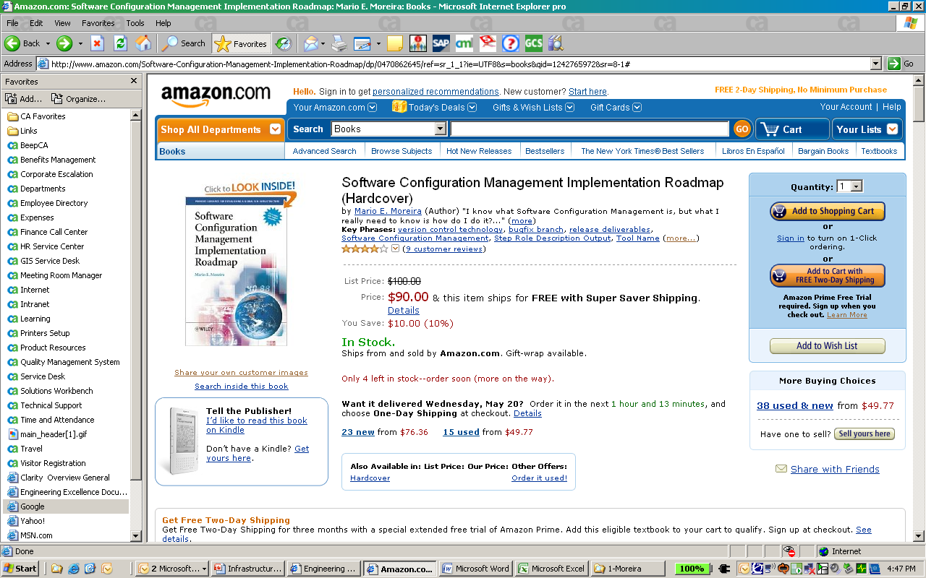
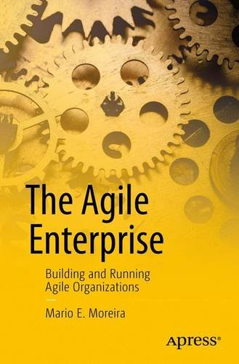
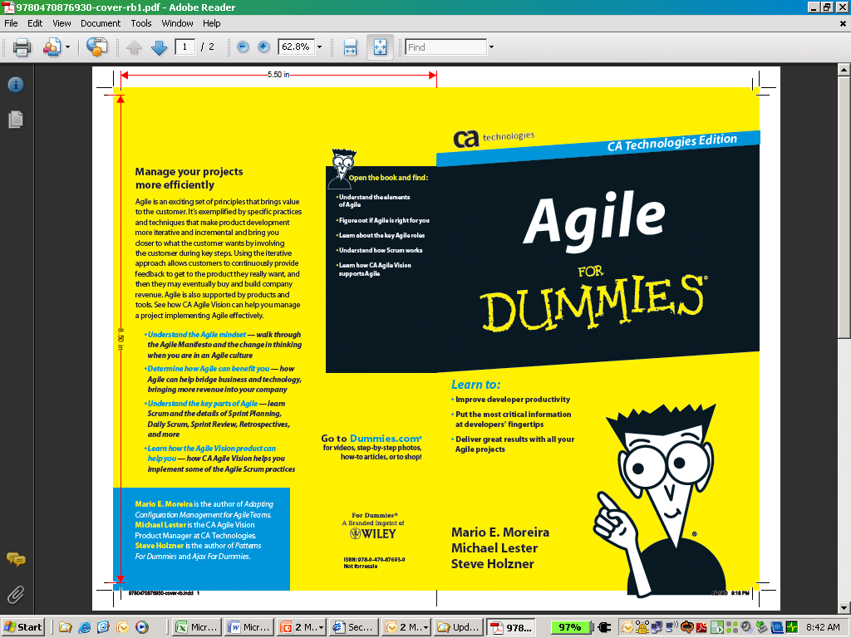
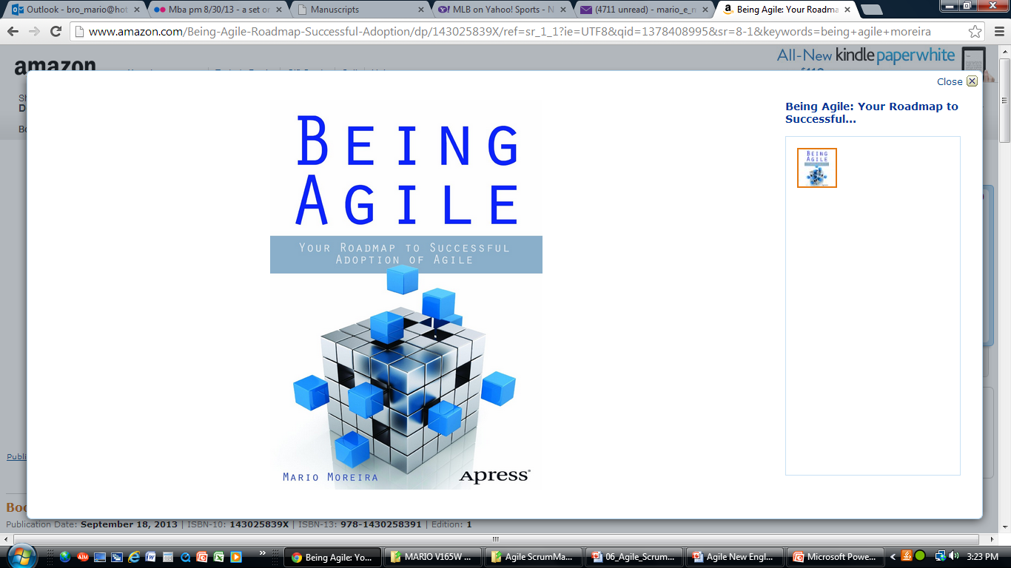

Mario Moreira
Master Agile Coach for Vistaprint helping us transform to Agile.
Writer of the Agile Adoption Roadmap Blog (at http://cmforagile.blogspot.com/)
Author of:
  The Agile Enterprise: Building and Running Agile Organizations, 2017, Apress (Springer)
  Being Agile: Your Roadmap to Successful Adoption of Agile, 2013, Apress (Springer)
  Agile for Dummies, 2010, Wiley and written for CA Agile Vision Product Marketing
  Adapting Configuration Management for Agile Teams, 2009, Wiley
  Software Configuration Management Implementation Roadmap, 2004, Wiley
Joining me: David Grabel & JP Beaudry

Slide 4

Welcome
Picture
Welcome to Build a Customer Value-Driven Enterprise
Intent is not to go deep
To provide you a Vision where your enterprise can go.
Notes:
Introduce yourself

Slide 5
Why this session?
Little visibility and transparency of the top ideas (aka, work) being worked on in the company
Companies are not truly aware of the value of their work and realize they are working on lower value work
Few can connect their team work to the top ideas or enterprise strategy
Too much focus on big batches where upward of 60% of features is rarely used
Agile is occurring in only parts of the Enterprise

Slide 6
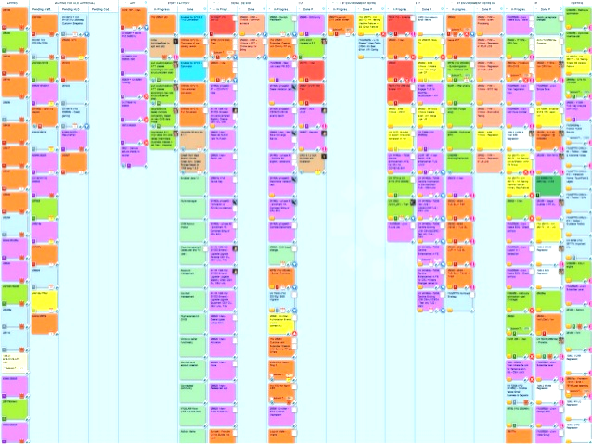
How many of you would have a hard time finding the list of top ideas being worked on across your company?

Slide 7
Why this session?
Little visibility and transparency of the top ideas (aka, work) being worked on in the company
Companies are not truly aware of the value of their work and realize they are working on lower value work
Few can connect their team work to the top ideas or enterprise strategy
Too much focus on big batches where upward of 60% of features is rarely used
Agile is occurring in only parts of the Enterprise

Slide 8
Have you ever been in a company where some teams are working on low value work?
$2,500,000
High
value
work
$2,250,000
$2,000,000
$1,750,000
$1,500,000
Unfortunately many companies find themselves in this situation
$1,250,000
$1,000,000
Low
value
work
$750,000
$500,000
$250,000
$0

Slide 9
Even when there is High Value work waiting in the pool that could generate a lot of money for the company
$2,500,000
Three $2,000,000 ideas are waiting
High
value
work
$2,250,000
and
waiting!
$2,000,000
$1,750,000
$1,500,000
$1,250,000
$1,000,000
Low
value
work
$750,000
$500,000
$250,000
$0

Slide 10
Would you find it better if your company only worked on the Highest Value work?
$2,500,000
High
value
work
$2,250,000
$2,000,000
$1,750,000
$1,500,000
And cut the tail of Low value work!
$1,250,000
$1,000,000
Low
value
work
$750,000
$500,000
$250,000
$0

Slide 11
Why this session?
Little visibility and transparency of the top ideas (aka, work) being worked on in the company
Companies are not truly aware of the value of their work and realize they are working on lower value work
Few can connect their team work to the top ideas or enterprise strategy
Too much focus on big batches where upward of 60% of features is rarely used
Agile is occurring in only parts of the Enterprise

Slide 12
How many of you can easily connect your current tasks to the company strategy?
Corporate Strategy
Division
Strategy
Top Ideas
Disconnect
Epic
User Story
Task

Slide 13
Why this session?
Little visibility and transparency of the top ideas (aka, work) being worked on in the company
Companies are not truly aware of the value of their work and realize they are working on lower value work
Few can connect their team work to the top ideas or enterprise strategy
Too much focus on big batches where upward of 60% of features is rarely used
Agile is occurring in only parts of the Enterprise

Slide 14
How many of you would like to avoid building the lower value work?
Big Idea
Lower or NO value

Slide 15
And instead only build the highest value of the idea?
High VALUE
Big Idea

Slide 16
Why this session?
Little visibility and transparency of the top ideas (aka, work) being worked on in the company
Companies are not truly aware of the value of their work and realize they are working on lower value work
Few can connect their team work to the top ideas or enterprise strategy
Too much focus on big batches where upward of 60% of features is rarely used
Agile is occurring in only parts of the Enterprise

Slide 17
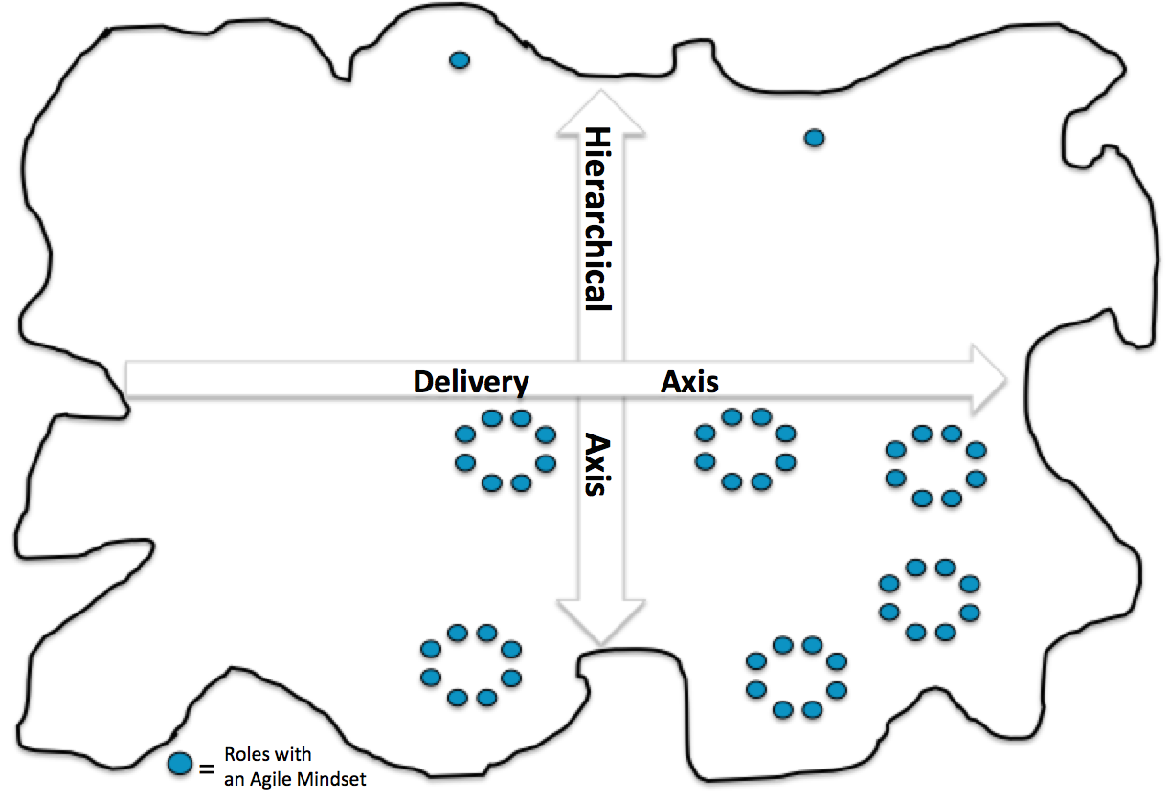
How many see Agile occurring in only parts of your enterprise?

Slide 18
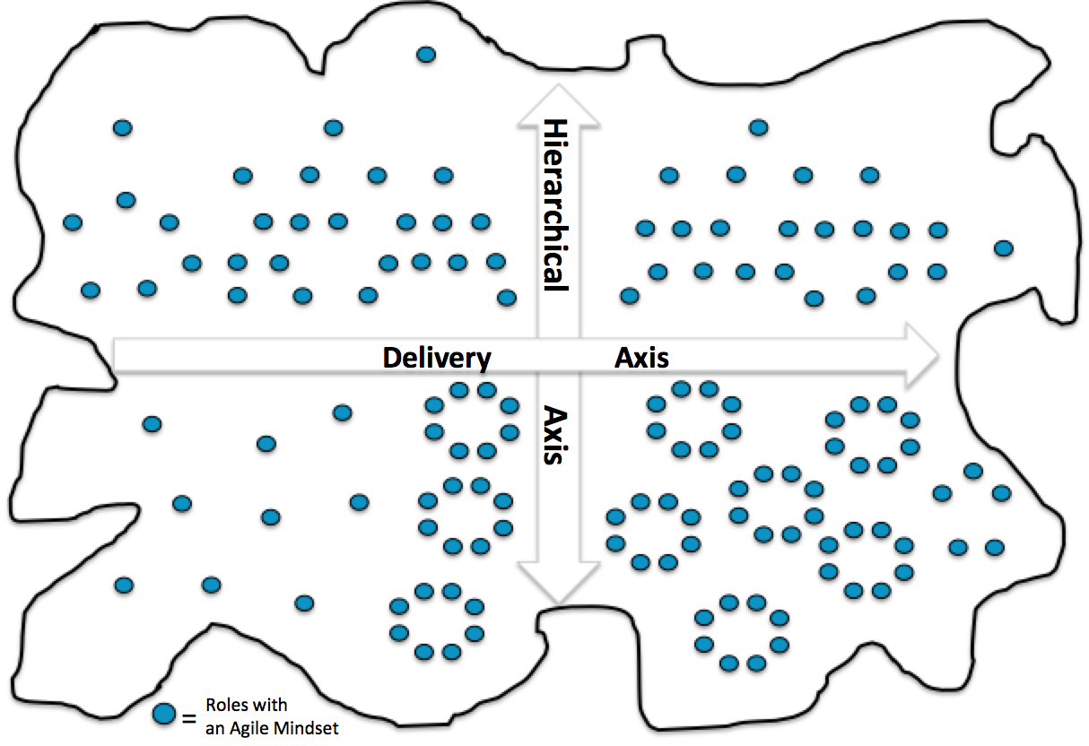
Agile needs to occurring in all part of the enterprise

Slide 19

We know the problem.
What do we do now?

Slide 20

How do you ensure all parts of the enterprise are connected and aligned to the highest value work?

Slide 21
The Customer
Value-Driven Engine

Slide 22
It begins with the concept of a Customer Value-Driven Engine
Provides an end-to-end view of how ideas flow across the enterprise
Ensures Teams are working on the highest value enterprise work
Provides visibility and transparency of your options and the work
Allows you to quickly be aware of new high-value work
A more adaptable way of managing the work and responding to feedback

Slide 23
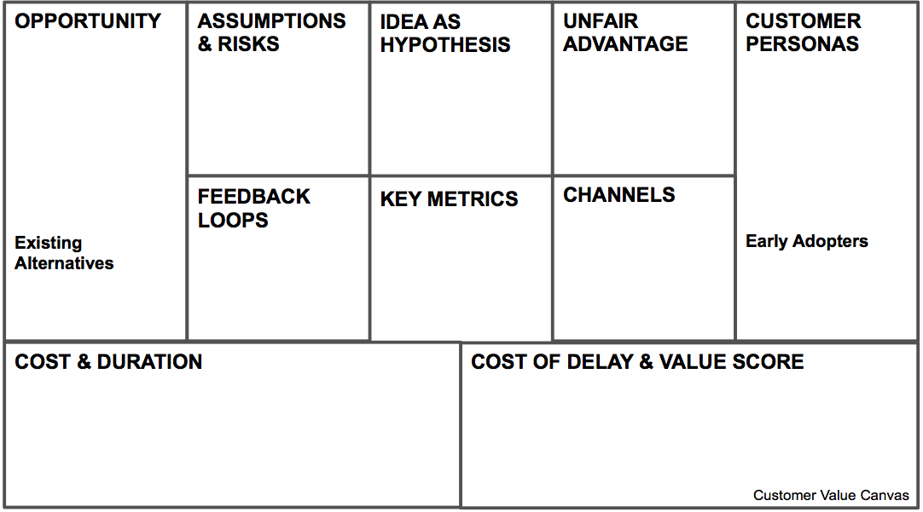
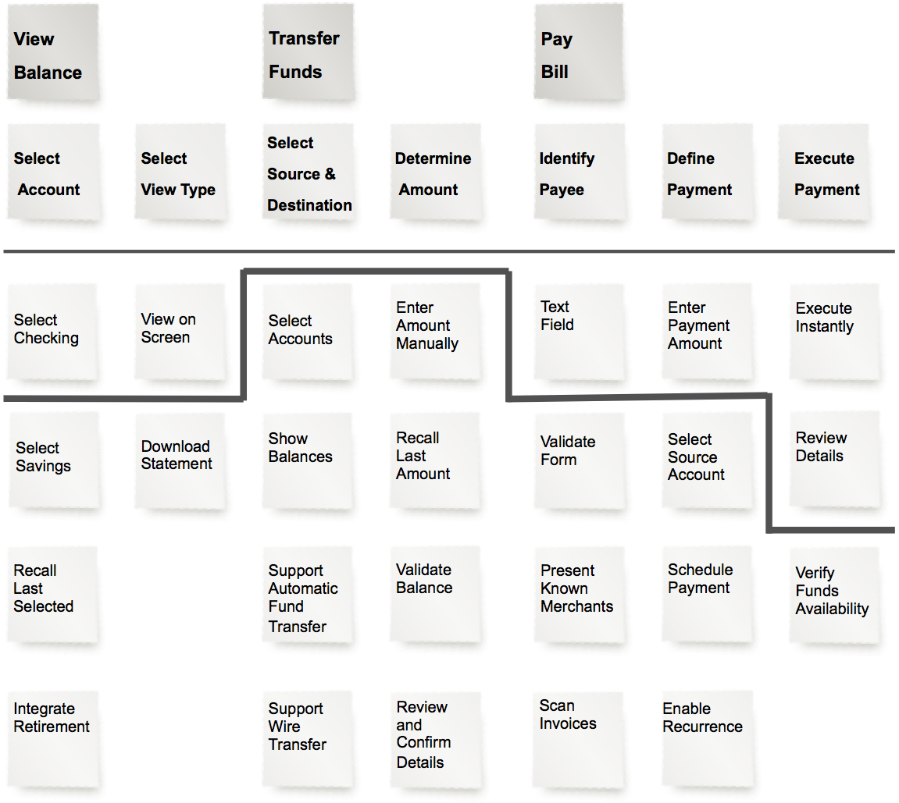
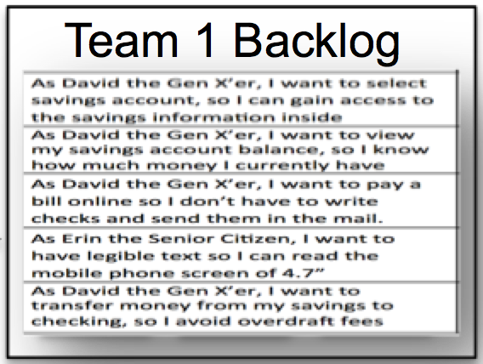
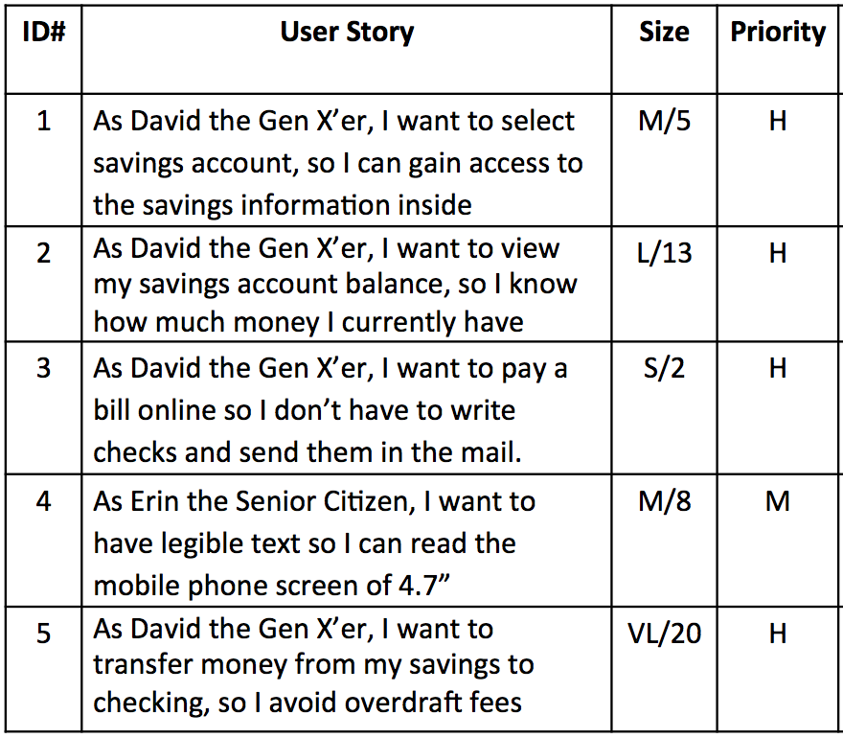
Mechanics for a Customer Value-Driven Engine
Enterprise Kanban of Ideas
Delivery Axis
Flow of Work
Record of Idea
Increment of Idea
Backlog of User Stories

Slide 24

Mindset for a Customer-Value Driven Engine
Discovery Mindset
Incremental Thinking
Feedback Loops
Self-organizing concepts
Experimental Thinking
Agile values and principles

Slide 25
6R Model
The framework behind the Engine

Slide 26

Introducing the 6R Model
Helps you understand the End-to-End flow of work through out an organization
Record
Reveal
Refine
Realize
Release
Reflect
Contribution by Emergn Ltd

Slide 27

Example of the Enterprise Idea Pipeline
The problem, possible ideas, persona, CoD, assumptions, and CD3 (value score). Once completed, add to the pool
The idea floats to its level of value. If high enough, it gets discussed (more effort investment is appropriate)
Pull the idea and cut an increment based on 6-prisms. Decomposition with story mapping
Groom and hone the epic to user stories. Apply an increment and iterative approach
The increment is packaged and released into production making it live
Assessment of market success

Slide 28
Putting Engine into Action
Record | Reveal | Refine | Realize | Release | Reflect

Slide 29
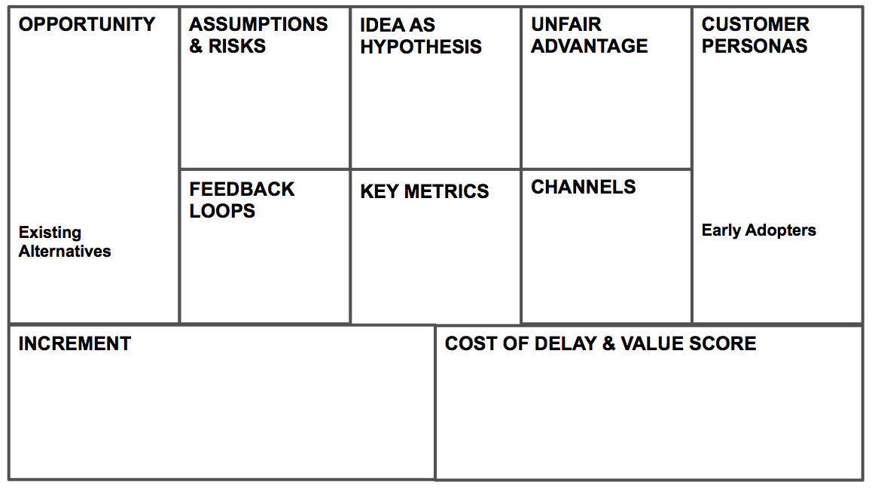
Record – Documenting the Idea
Record | Reveal | Refine | Realize | Release | Reflect
Capture new Customers who are Mobile-centric

Slide 30
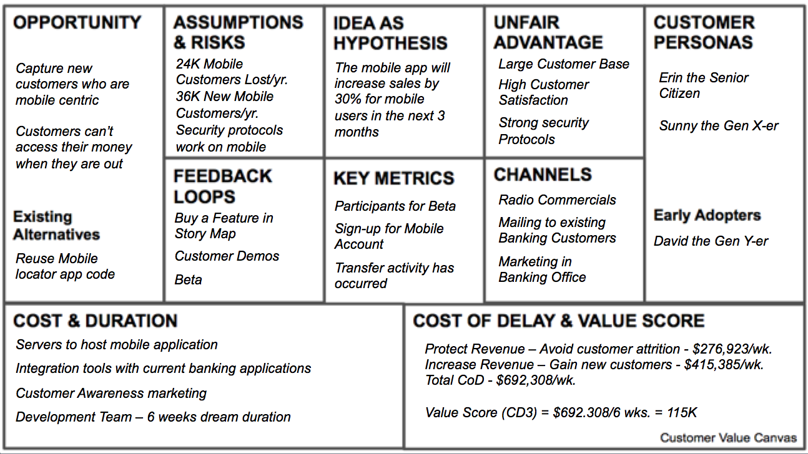
Record – Customer Value Canvas
INCREMENT
Using the 6-Prisms, the first increment should focus on Value and Stakeholder

Slide 31
Capturing the Idea Exercise
Think of a business idea you have from work or from home.
Document the idea in the Opportunity box of your Customer Value Canvas
Document what group of people it may be for in the Customer Personas box
Document the Feedback loops you may need to validate the value of this idea in the Feedback Loops box
Notes:
Unfortunately we don’t have time to dive into each one of these, we also realise that some of you are experts in this field.
However it’s still worth us having a discussion around what type of tools/methods we are using at Vistaprint so that we can be on the same page and help each other out.

Slide 32
Reveal – Value with CoD & CD3
Record | Reveal | Refine | Realize | Release | Reflect

Slide 33
Reveal – Cost of Delay (CoD)
Delaying Business Value and making Money for the customer
DELAY COST
Value Realised
Late Entry
Time
For ideas with a very long-life, with peak unaffected by delay

Slide 34
CoD - a framework for thinking about value
Increase Revenue
Increasing sales to new or existing customers. Delighting or Disrupting to increase market share and size
Protect Revenue
Improvements and incremental innovation to sustain current market share and revenue figures
Reduce
Costs
Costs that we are currently incurring, that can be reduced. More efficient, improved margin or contribution
Avoid
Costs
Improvements to sustain current cost base. Costs we are not currently incurring but may do in the future
Notes:
To get to Cost of Delay, you have to start with the benefits
To make this easy and fast we used a simple framework to help us think about what the value of a feature might be.
4 benefit types that a idea or feature can contribute to one or more of.
<explain>
Each and every requirement was discussed using these terms.
Like a scaffolding for thinking about the value to the organisation
Increase Revenue
This is the revenue associated with either increasing sales to existing customers or gaining new customers. This may involve increasing share of wallet, market share or even the size of the market itself. This could be by making changes that add value to existing products or services that customers are willing to pay for, or new products or services that either existing or new customers are willing to pay for. The changes you develop here are likely to be “delighting” features for either current customers, or new ones. This is also where “disruptive innovation” occurs, enabling new business models and increasing the size of the market by serving new markets and undercutting others.
Protect Revenue
This is the revenue that is currently being received from existing customers who are paying for current products and services. Sustaining this revenue often requires ongoing improvements to at least keep up with competitors and maintain existing market share. The actions taken here are more defensive in nature, making processes faster and easier to use and removing any pain that might drive them to consider switching to a competing product or service. The changes made here are not valuable enough for existing customers to pay extra though. This is the basic maintenance of existing products and services that could be described as “sustaining innovations”.
Reduce Costs
These are the ideas about how to be more efficient fit. The changes that contribute to this bucket will reduce the costs that we are currently incurring. Typical examples of this could be changes that speed up or automate processes, reducing the number of FTEs required. It could also result in savings in overheads, equipment or other costs.
Avoid Costs
These are costs we are not currently incurring but there is some likelihood that we will in the future, unless some action is taken. Some examples of these might be additional FTEs required to handle a new process, fines we may have to pay, or loss of reputation that impacts goodwill or brand value. This category would typically include a lot of things that many organisations might consider to be operational or strategic risks – often with an estimate of the probability of an event occurring.

Slide 35
Reveal – Calculating CoD and CD3
Determine the potential revenue for a year
– Avoid customer attrition - $14,400,000/year
– Gain new customers - $21,600,000/year
Protect Revenue
Increase Revenue
CoD – The potential revenue for a year and divide by 52
– Avoid customer attrition - $276,923/wk
– Gain new customers - $415,385/wk
Total CoD - $692,308/wk
Protect Revenue
Increase Revenue

Slide 36
Reveal – Calculating CoD and CD3
Total CoD - $692,308/wk
CD3 – Cost of delay divided by duration
Dream Duration = 6 weeks
Value Score (CD3) = $692,308/6 wks. = 115K

Slide 37
CoD – Focusing on the higher value work
$2,500,000
High
value
work
$2,250,000
$2,000,000
$1,750,000
$1,500,000
And cut the tail of Low value work!
$1,250,000
$1,000,000
Low
value
work
$750,000
$500,000
$250,000
$0

Slide 38
Value (CoD and CD3) Exercise
Determine how much money your idea might make in a year.
Calculate the CoD (divide by 52 weeks)
Determine the duration of work
Calculate the CD3 value score by taking CoD and divide by duration.
Write the response into the Cost of Delay & Value Score box of your Customer Value Canvas
Notes:
Unfortunately we don’t have time to dive into each one of these, we also realise that some of you are experts in this field.
However it’s still worth us having a discussion around what type of tools/methods we are using at Vistaprint so that we can be on the same page and help each other out.

Slide 39
Reveal – Prioritizing
Record | Reveal | Refine | Realize | Release | Reflect
115,000
17,000
19,000
Notes:
Order of magnitude
Pass back to Mario

Slide 40
For ideas of close value, how do we prioritize?
Customers on the site will quickly find stuff that they want, purchase, and grow their business a lot.
Value | Duration | Score
$400K/wk | 24 wks | 17,000
17,000
Customers can create baskets and load them up.
Value | Duration | Score
$850K/wk | 44 wks | 19,000
19,000
Notes:
Unfortunately we don’t have time to dive into each one of these, we also realise that some of you are experts in this field.
However it’s still worth us having a discussion around what type of tools/methods we are using at Vistaprint so that we can be on the same page and help each other out.

Slide 41
Reveal – Challenging Assumptions
Record | Reveal | Refine | Realize | Release | Reflect
“Remind me how you got to that?”
“What is your level of uncertainty?”
“What led you to that conclusion?”
“What information is needed to validate this?”
“Why do you think it will happen this way?”

Slide 42
High-Value Open-ended Questions to challenge assumptions
“Remind me how you got to that?”
“What is your level of uncertainty?”
“What led you to that conclusion?”
“Have you thought of another approach?”
“What information is needed to validate this?”
“Why do you think it will happen this way?”
“Where is the uncertainty?”
“What is your riskiest assumption, why?”

Slide 43
Challenging Assumptions Exercise
Document 3 underlying assumptions you made in determining the Value Score in the Assumptions and Risks box.
Pair up with someone and share your assumptions
The other person in the pair should use the High-Value Open-ended Questions and challenge the assumptions
Notes:
Underlying assumptions
Unfortunately we don’t have time to dive into each one of these, we also realise that some of you are experts in this field.
However it’s still worth us having a discussion around what type of tools/methods we are using at Vistaprint so that we can be on the same page and help each other out.

Slide 44
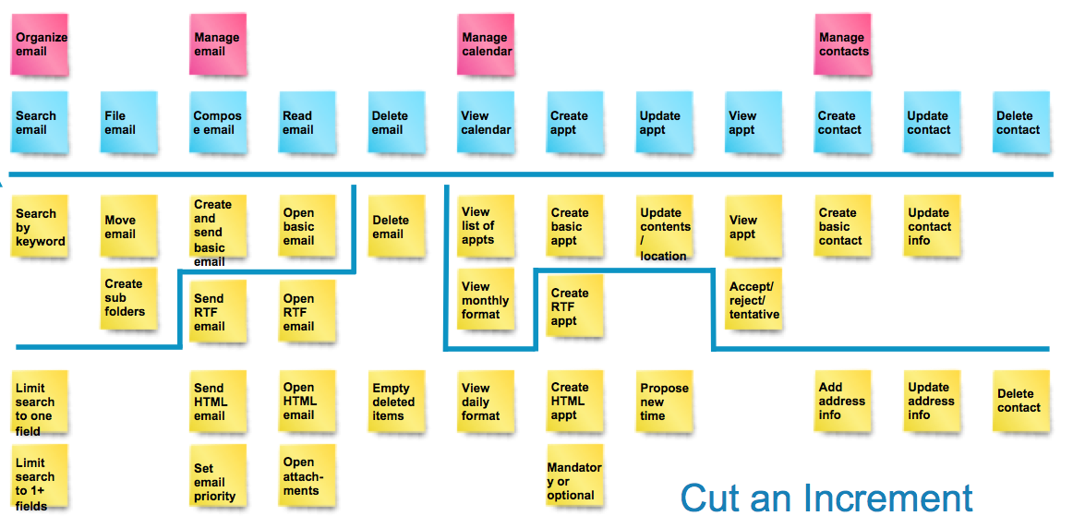
Refine – Validating Value with an Increment
Record | Reveal | Refine | Realize | Release | Reflect

Slide 45


Refine –Incremental Thinking
Big Upfront Thinking
Incremental Thinking
Mind
the
Gap!
Incremental
Thinking
Delivering
Customer
Value

Slide 46
Incremental Thinking Exercise
Review your Idea from your Canvas.
Document 3 ways to that you can cut an increment of your idea in the Increment box to validate that it is a valuable idea
Notes:
Unfortunately we don’t have time to dive into each one of these, we also realise that some of you are experts in this field.
However it’s still worth us having a discussion around what type of tools/methods we are using at Vistaprint so that we can be on the same page and help each other out.

Slide 47
Refine – Story Mapping
A simple method to help you break down ideas while keeping sight of the user experience and big picture
Describes the user journey steps in high level (from left to right)
Describes what happens in each step of the user journey in detail from the customer’s perspective
Notes:
Increment of 6 weeks or less
Must be functional and produce feedback
Consider establishing a hypothesis
End-to-end flow of the idea
Base it on 6 Prisms (e.g., Value, Geography, Stakeholders, Necessity, Urgency, and Risk)

Slide 48
Backbone
Big activities that the users engage with
Activities
The process steps a
customer goes
Organize email
Manage email
Manage calendar
Manage contacts
Search email
File
email
Compose email
Read
email
Delete
email
View calendar
Create
appt
Update appt
View
appt
Create contact
Update contact
Delete contact
Search
by keyword
Move email
Create and send basic email
Open
basic email
Delete email
View
list of appts
Create basic appt
Update contents
/ location
View
appt
Create basic contact
Update contact info
Create sub folders
Send
RTF
email
Open
RTF
email
View monthly format
Create
RTF
appt
Accept/
reject/
tentative
Increment
Limit search to one field
Send HTML email
Open
HTML email
Empty deleted items
View
daily format
Create HTML appt
Propose new
time
Add address info
Update address info
Delete contact
Priority
Limit search to 1+ fields
Set email priority
Open attach-
ments
Mandatory or optional
Options –
for each activity from a customer point of view.
Search attach-
ments
Get address from contacts
View weekly format
Get address from contacts
View
attach-
ments
Import contacts
Search sub folders
Send attach-
ments
Search calendar
Send
attach-
ments
Export contacts
Source: Jeff Patton User Story Mapping
Notes:
1. If you’re using cards or sticky notes, write down a few words about your idea immediately after thinking it.
2. Explain your idea to others as you point to the sticky note or card. Use big gestures. Draw more pictures. Tell stories.
3. Place the card or sticky into a shared workspace where everyone can see, point to, add to, and move it around. Hopefully, there will be lots of other ideas from you and others in this growing pile.
Write down ideas as they come to mind and wait for the right moment to inject
Talk, sketch and write and photograph your results
As you slice: Focus on outcomes not outputs

Slide 49
Refine – Story of Story Mapping
Delete
email
Create and send basic email
Open
basic email
Create basic appt
View
list of appts
Manage calendar
Create sub folders
Export contacts
Import contacts
File
email
Send
RTF
email
Open
RTF
email
View monthly format
Create
RTF
appt
Delete email
Accept/
reject/
tentative
Update contact
Search
by keyword
Move email
View
appt
Empty deleted items
Update appt
Add address info
Update address info
Update contact info
Manage email
Limit search to one field
Send HTML email
Open
HTML email
View
daily format
Create HTML appt
Propose new
time
Manage contacts
Read
email
View calendar
View
attach-
ments
Update contents
/ location
Limit search to 1+ fields
Get address from contacts
Set email priority
Open attach-
ments
View weekly format
Mandatory or optional
Delete contact
Search attach-ments
Organize email
Search email
Create basic contact
Create
appt
Delete contact
View
appt
Compose email
Search calendar
Send attach-ments
Send attach-ments
Create contact
Search sub folders
Get address from contacts
Quiet Brainstorming
Source: Jeff Patton User Story Mapping
Notes:
1. If you’re using cards or sticky notes, write down a few words about your idea immediately after thinking it.
2. Explain your idea to others as you point to the sticky note or card. Use big gestures. Draw more pictures. Tell stories.
3. Place the card or sticky into a shared workspace where everyone can see, point to, add to, and move it around. Hopefully, there will be lots of other ideas from you and others in this growing pile.
Write down ideas as they come to mind and wait for the right moment to inject
Talk, sketch and write and photograph your results
As you slice: Focus on outcomes not outputs

Slide 50
Search
by keyword
Move email
Create and send basic email
Open
basic email
Delete email
View
list of appts
Create basic appt
Update contents
/ location
View
appt
Create basic contact
Update contact info
Delete contact
Limit search to one field
Create sub folders
Send
RTF
email
Open
RTF
email
Empty deleted items
View monthly format
Create
RTF
appt
Propose new
time
Accept/
reject/
tentative
Add address info
Update address info
Limit search to 1+ fields
Send HTML email
Open
HTML email
View
daily format
Create HTML appt
View
attach-
ments
Search attach-ments
Set email priority
Open attach-
ments
Mandatory or optional
Search sub folders
Get address from contacts
Affinity Mapping
Notes:
1. If you’re using cards or sticky notes, write down a few words about your idea immediately after thinking it.
2. Explain your idea to others as you point to the sticky note or card. Use big gestures. Draw more pictures. Tell stories.
3. Place the card or sticky into a shared workspace where everyone can see, point to, add to, and move it around. Hopefully, there will be lots of other ideas from you and others in this growing pile.
Write down ideas as they come to mind and wait for the right moment to inject
Talk, sketch and write and photograph your results
As you slice: Focus on outcomes not outputs

Slide 51
Backbone
Activities .
Organize email
Manage email
Manage calendar
Manage contacts
Search email
File
email
Compose email
Read
email
Delete
email
View calendar
Create
appt
Update appt
View
appt
Create contact
Update contact
Delete contact
Search
by keyword
Move email
Create and send basic email
Open
basic email
Delete email
View
list of appts
Create basic appt
Update contents
/ location
View
appt
Create basic contact
Update contact info
Delete contact
Limit search to one field
Create sub folders
Send
RTF
email
Open
RTF
email
Empty deleted items
View monthly format
Create
RTF
appt
Propose new
time
Accept/
reject/
tentative
Add address info
Update address info
Limit search to 1+ fields
Send HTML email
Open
HTML email
View
daily format
Create HTML appt
View
attach-
ments
Search attach-ments
Set email priority
Open attach-
ments
Mandatory or optional
Search sub folders
Get address from contacts
Affinity Mapping
Notes:
1. If you’re using cards or sticky notes, write down a few words about your idea immediately after thinking it.
2. Explain your idea to others as you point to the sticky note or card. Use big gestures. Draw more pictures. Tell stories.
3. Place the card or sticky into a shared workspace where everyone can see, point to, add to, and move it around. Hopefully, there will be lots of other ideas from you and others in this growing pile.
Write down ideas as they come to mind and wait for the right moment to inject
Talk, sketch and write and photograph your results
As you slice: Focus on outcomes not outputs

Slide 52
Organize email
Manage email
Manage calendar
Manage contacts
Search email
File
email
Compose email
Read
email
Delete
email
View calendar
Create
appt
Update appt
View
appt
Create contact
Update contact
Delete contact
Search
by keyword
Move email
Create and send basic email
Open
basic email
Delete email
View
list of appts
Create basic appt
Update contents
/ location
View
appt
Create basic contact
Update contact info
Create sub folders
Send
RTF
email
Open
RTF
email
View monthly format
Create
RTF
appt
Accept/
reject/
tentative
Limit search to one field
Send HTML email
Open
HTML email
Empty deleted items
View
daily format
Create HTML appt
Propose new
time
Add address info
Update address info
Delete contact
Priority
Limit search to 1+ fields
Set email priority
Open attach-
ments
Mandatory or optional
Prioritize
Search attach-ments
Get address from contacts
View weekly format
Get address from contacts
View
attach-
ments
Import contacts
Search sub folders
Send attach-ments
Search calendar
Send attach-ments
Export contacts
Notes:
1. If you’re using cards or sticky notes, write down a few words about your idea immediately after thinking it.
2. Explain your idea to others as you point to the sticky note or card. Use big gestures. Draw more pictures. Tell stories.
3. Place the card or sticky into a shared workspace where everyone can see, point to, add to, and move it around. Hopefully, there will be lots of other ideas from you and others in this growing pile.
Write down ideas as they come to mind and wait for the right moment to inject
Talk, sketch and write and photograph your results
As you slice: Focus on outcomes not outputs

Slide 53
Organize email
Manage email
Manage calendar
Manage contacts
Search email
File
email
Compose email
Read
email
Delete
email
View calendar
Create
appt
Update appt
View
appt
Create contact
Update contact
Delete contact
Search
by keyword
Move email
Create and send basic email
Open
basic email
Delete email
View
list of appts
Create basic appt
Update contents
/ location
View
appt
Create basic contact
Update contact info
Create sub folders
Send
RTF
email
Open
RTF
email
View monthly format
Create
RTF
appt
Accept/
reject/
tentative
Limit search to one field
Send HTML email
Open
HTML email
Empty deleted items
View
daily format
Create HTML appt
Propose new
time
Add address info
Update address info
Delete contact
Priority
Limit search to 1+ fields
Set email priority
Open attach-
ments
Mandatory or optional
Cut an Increment
Search attach-
ments
Get address from contacts
View weekly format
Get address from contacts
View
attach-
ments
Import contacts
Search sub folders
Send attach-
ments
Search calendar
Send
attach-
ments
Export contacts
Notes:
1. If you’re using cards or sticky notes, write down a few words about your idea immediately after thinking it.
2. Explain your idea to others as you point to the sticky note or card. Use big gestures. Draw more pictures. Tell stories.
3. Place the card or sticky into a shared workspace where everyone can see, point to, add to, and move it around. Hopefully, there will be lots of other ideas from you and others in this growing pile.
Write down ideas as they come to mind and wait for the right moment to inject
Talk, sketch and write and photograph your results
As you slice: Focus on outcomes not outputs

Slide 54
Refine – Benefits of Increments
Avoids Big Batch work
Value may be found in fewer increments
Ability to adapt to new incoming high-value ideas
Notes:
Increment of 6 weeks or less
Must be functional and produce feedback
Consider establishing a hypothesis
End-to-end flow of the idea
Base it on 6 Prisms (e.g., Value, Geography, Stakeholders, Necessity, Urgency, and Risk)

Slide 55
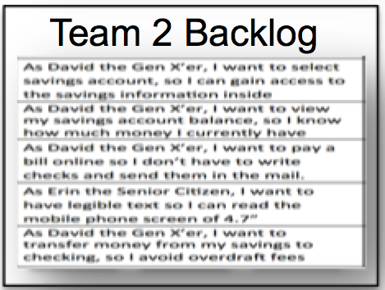
Realize
Record | Reveal | Refine | Realize | Release | Reflect
Notes:
This is where Scrum, Kanban, XP, and other Agile methods occur

Slide 56
Realize – Grooming to User Stories
Story Mapping
Backlog
Story
Map
Epics
User Stories

Slide 57
Team 1 Backlog
What are some challenges when two teams must work on one Increment of an Idea?
User Story
User Story
User Story
User Story
User Story
Team 2 Backlog
User Story
User Story
User Story
User Story
User Story
User Story
Notes:
Unfortunately we don’t have time to dive into each one of these, we also realise that some of you are experts in this field.
However it’s still worth us having a discussion around what type of tools/methods we are using at Vistaprint so that we can be on the same page and help each other out.

Slide 58

Release
Record | Reveal | Refine | Realize | Release | Reflect
Bank
App on
Mobile phone
Notes:
DevOps

Slide 59

Reflect
Record | Reveal | Refine | Realize | Release | Reflect
Business Outcomes
Bank
App on
Mobile phone

Slide 60
Record | Reveal | Refine | Realize | Release | Reflect
Culture for the 6R Model Exercise
What culture and behavioral change must occur at each stage of the 6R model to allow an enterprise Customer Value-Driven Engine to work effectively?
Notes:
Unfortunately we don’t have time to dive into each one of these, we also realise that some of you are experts in this field.
However it’s still worth us having a discussion around what type of tools/methods we are using at Vistaprint so that we can be on the same page and help each other out.

Slide 61
What will you do?
Pick one area along the 6R model that you can act upon to get become more customer value-driven?

Slide 62
Reflections
Notes:
How do you react to this? Do they make sense in your world?

Slide 63

Challenges in Following Scrum
Questions
Wrap up
Ideas?
Comments
Thoughts?

Slide 64
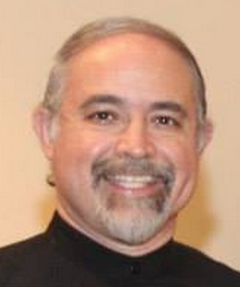
Thank you!
Follow me at:
  My Agile Adoption Roadmap Blog at http://cmforagile.blogspot.com/
  On Twitter at: @AgileMario
Notes:
MM & JP

